Slide 1

Visualization and Analysis – Tutorial Presentation for Feedback Date:
Group Id: A177 Name of Student Presenting:

Slide 2
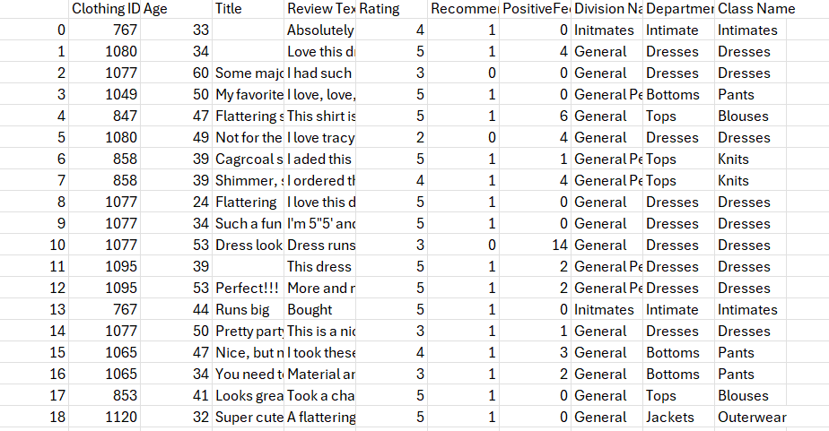
We are using the dataset DS147- Womens Clothing E-Commerce Reviews.csv to answer our Research Question “Is there a difference in the proportion of highly rated products between young and old women ?” ¹
The dataset has 23486 rows
The dependent variable³ is
Highly rated products(Rating)
The independent variable⁴ is
Young and Old Women (Age)
The dataset represent the Age, Recommended IND, Rating, Department name, and different other attributes of clothing E-Commerce.

Slide 3
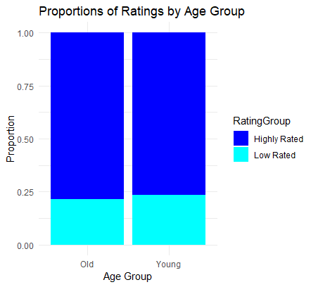
Bar chart
Part 1: VISUALISATION

Slide 4
Here is a table (matrix/cross tabulation) showing our dependent variable as rows, and our independent variable as columns. We have at least two values for both variables that are independent of each other (no overlap).
For example:
Our RQ is about Differences in proportions
 | Age
Rating | Young | Old
highly rated | 8618 | 9590
Low rated | 2632 | 2646
For comparison of proportions analysis, we will use a chi-square test to check for the likelihood that there is a relationship between the two nominal variables. This non-parametric test makes no assumptions about the shape of the data (which is nominal, not interval) so we do not include a histogram for this test.
4
Notes:
4

Slide 5
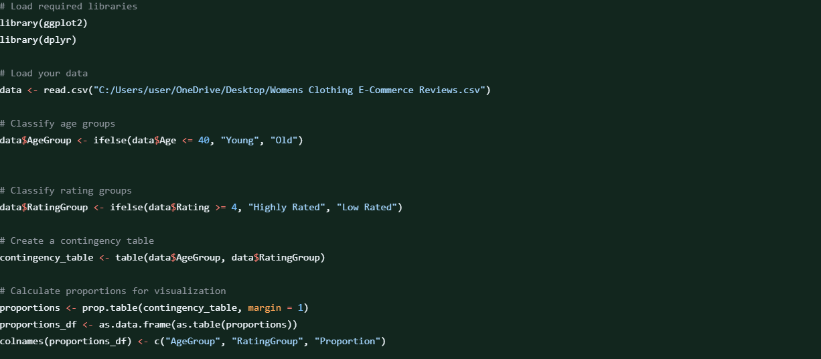
R Script and Results – The Analysis
Include a snippet of the R code you use to calculate your test statistic.

Slide 6


Slide 7


Slide 8
The Value of the Test Statistics
Contingency Table
Highly Rated Low Rated
Old 9590 2646
Young 8618 2632
"Chi-Square Test Results:"
Pearson’s Chi-squared test with Yates' continuity correction
data: contingency_table
X-squared = 10.448, df = 1, p-value = 0.001228

Slide 9
P- Value
P- Value
P-value:p= 0.001228
Is p-value > or < 0.05?
p<0.05

Slide 10
Is the result significant?
To determine if the result is significant, compare the p-value to the chosen significance level (typically 0.05):
p-value = 0.001228 is less than 0.05, so the result is significant.

Slide 11
Decision on the Null Hypothesis
Since the p-value is less than the significance level of 0.05, we reject the null hypothesis (H₀).
Conclusion: There is sufficient evidence to conclude that there is a difference in the proportions of highly rated products between young and old women.

Slide 12
Implications of the Results for Understanding the Research Question (RQ)
The significant result suggests that age (young vs. old women) is associated with differences in the proportions of highly rated products. This means that the age of women might have an influence on whether products are rated highly or not.
The significant result indicates that age influences product ratings, with younger and older women rating products differently. This suggests that product development and marketing strategies should account for age-based preferences, with younger women potentially valuing trends and innovation, while older women may prioritize comfort and reliability. Retailers should consider segmenting their audience for targeted campaigns and product offerings.

